Slide 1
Visualizing Covid and government measures
By Eamon Worden

Slide 2
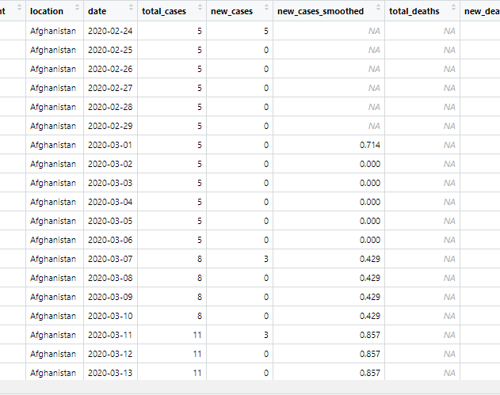
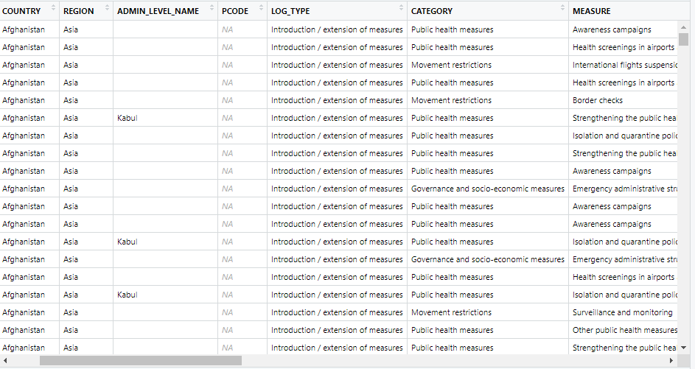
DataViz Purpose
Understand Covid
Trends across region
Trends over time
Effect of various events
Understand government measures
When they were used
Effectiveness

Slide 3
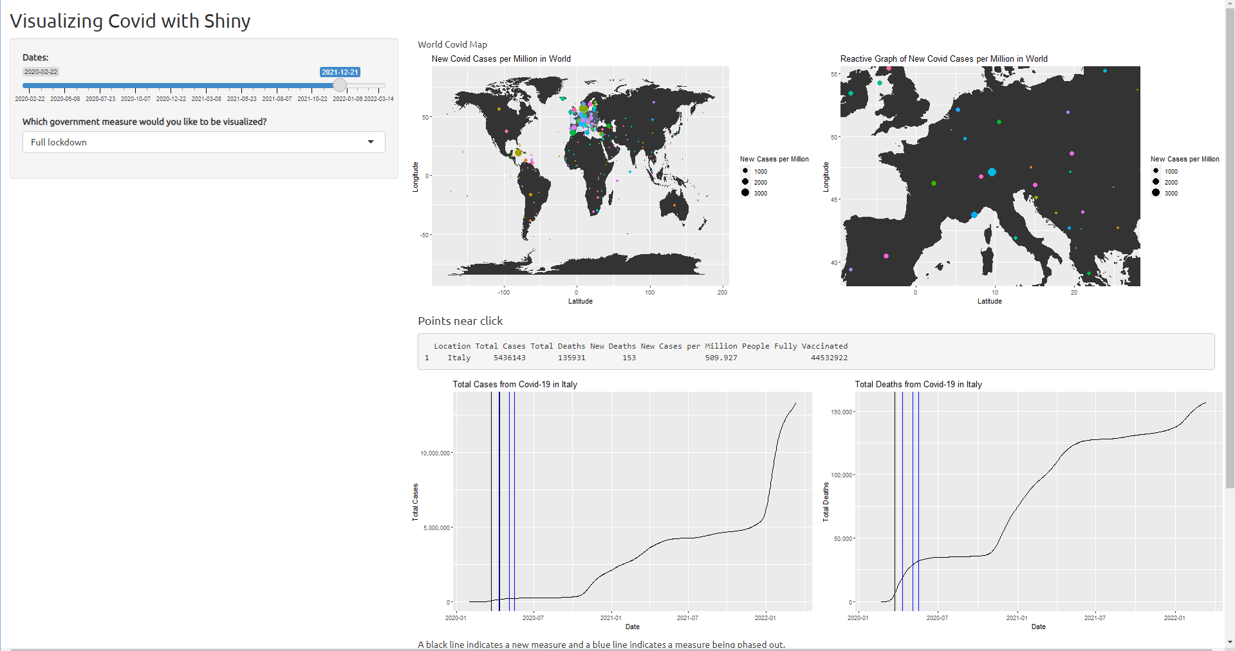
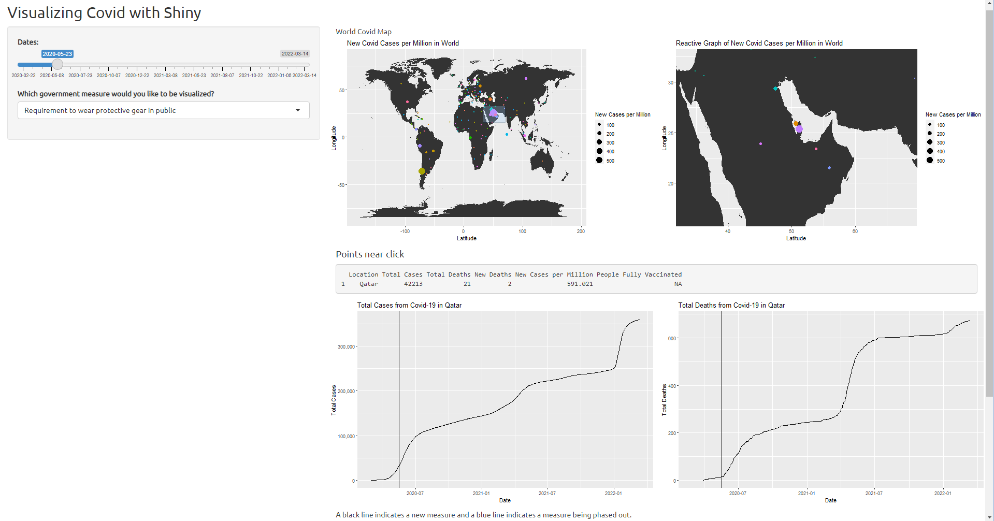
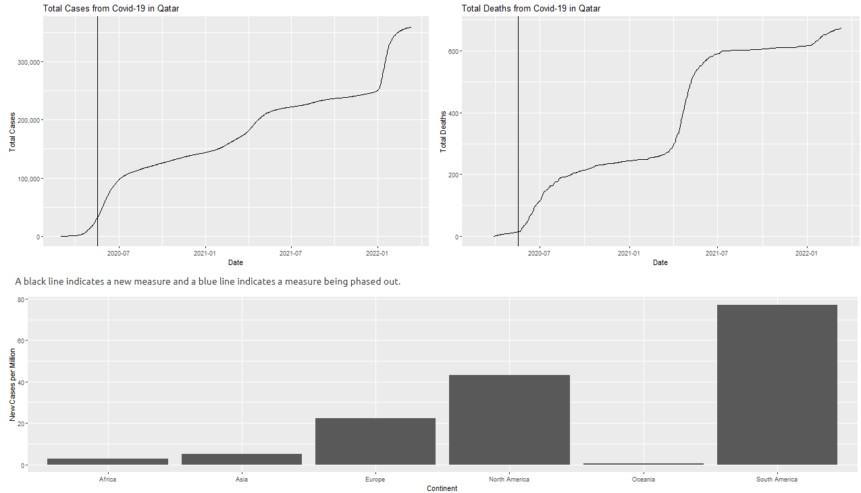
Questions
How did covid trend differently in different places of the world?
What government measures were used and were they effective?
How did other events affect covid-19?

Slide 4
Insights
Covid was sinusoidal in most areas
Super spreader events were noticeable
August 14th concert in UK
Countries and continents varied a lot
Government measures were sparse
Typically employed in first wave
Rarely employed during other waves
Vaccines? Pandemic fatigue? Unrest?
Typically effective
Difficult to determine real effectiveness

